Slide 1

FIBERONE TECH ACADEMY
                JANUARY 2025
by Michael Adesanya

Slide 2

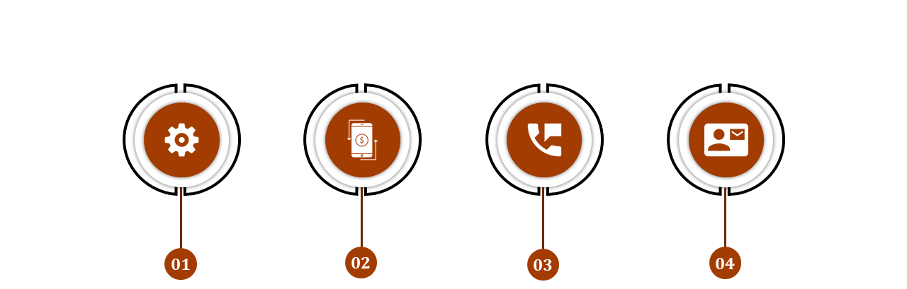




FOB TECH ACADEMY
MODULES:
Trenching and Digging
Equipment Operation and Maintenance
Installation Techniques
Project Management and Safety
  Regulatory Compliance
  Hazard Identification
  Personal Protective Equipment (PPE)

Slide 3
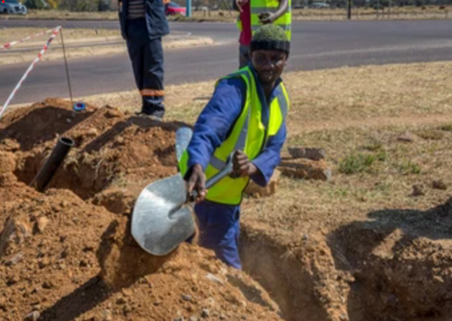
FOB TECH ACADEMY
Trenching and Digging
What is Trenching?
It means the act of creating a narrow excavation below the surface of the ground by using an earthmoving machine called a trencher.
Trenching is a foundational step in fiber optic cable deployment when deploying through underground or carrying out maintenance, the same way power cable for electricity are laid, fiber duct of either 32mm or 40mm are laid which fiber are installed after.
What to considered when carrying out trenching
and digging;
regulatory compliance hazard identification,
personal protective equipment (PPE),
equipment operation and maintenance
environmental consideration.

Slide 4



FOB TECH ACADEMY
Regulatory Compliance in Fiber Optic Network Installation
  National and Local Regulation:
  Responsible for permits and approvals.
  Must be consulted before any civil work
  Issue Right-of-Way (ROW), construction, and operation permits.
    Example: Lagos State Infrastructure Maintenance Agency (LASIMRA), Ministry of Works, Lekki Conservation centers, etc.
  Industry Standard and Guidelines:
  are set to ensure uniformity, safety and performance in fiber installation Example: ISO/IEC standards, ITU-T regulations.
  National standard:
  they are responsible in giving rules for all fiber practitioners, which determine how civil work are been carryout
    Example; NCC, NEC etc.

Slide 5
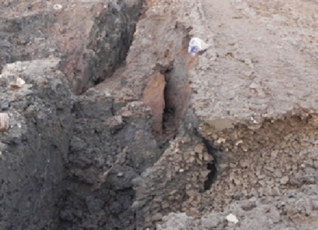
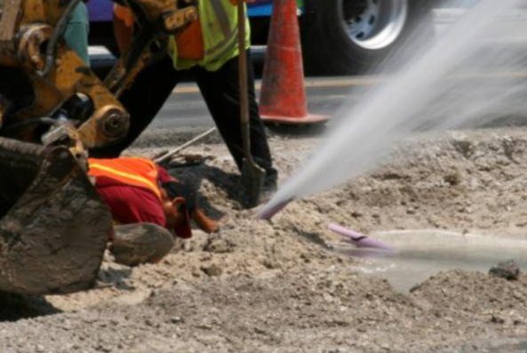
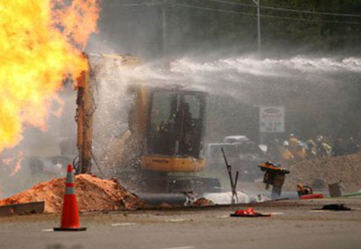
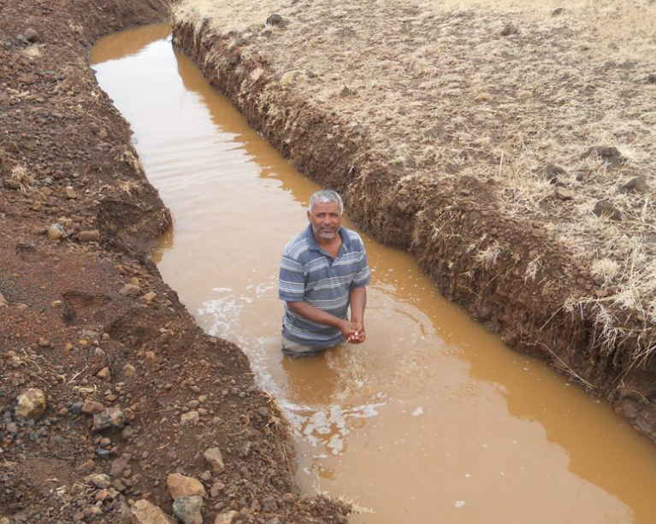
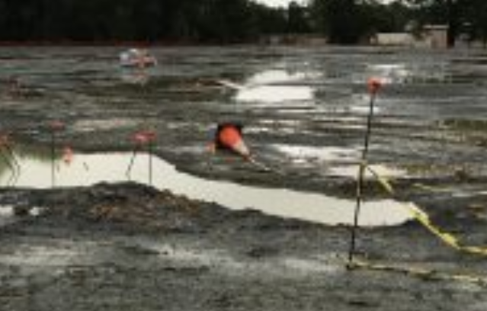
FOB TECH ACADEMY
Hazard Identification
Machinery-Related Hazard
Trench Collapse (Cave-ins
Utility Strikes
Water Accumulation
Weather
Falls and Falling Objects

Slide 6



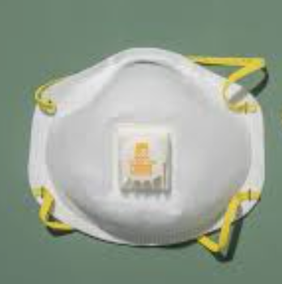
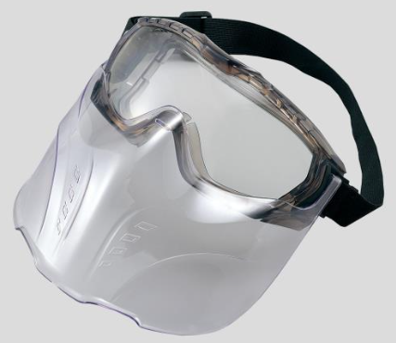
FOB TECH ACADEMY
Personal Protective Equipment (PPE)
3. Hand Protection
Gloves: Protect hands from cuts, abrasions, and exposure to chemicals or sharp objects.
Material: Use heavy-duty gloves made of leather, rubber, or synthetic materials suitable for trenching tasks.
1. Head Protection
Hard Hats: Protect against falling debris, tools, or materials that may strike workers..
4. Respiratory Protection
Dust Masks or Respirators: Protect workers from inhaling dust, hazardous gases, or particulate matter in trenches.
2. Eye and Face Protection
Safety Goggles or Face Shields: Prevent injuries from flying particles, dust, or splashes during digging and material handling.

Slide 7

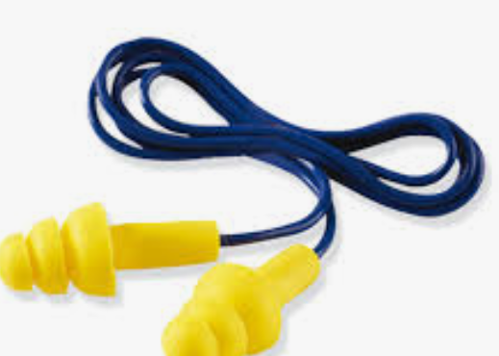
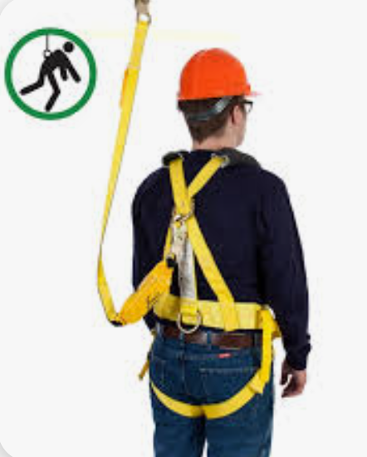

FOB TECH ACADEMY
Personal Protective Equipment (PPE)
Foot Protection
Steel-Toe Boots: Shield feet from heavy objects, sharp debris, and uneven terrain..
Ear Protection
plugs or Earmuffs: Protect against noise from heavy machinery or equipment used during excavation.
Body Protection
High-Visibility Vests: Make workers easily identifiable, especially near machinery or in low-visibility conditions.
Fall Protection Equipment
Harnesses and Lanyards: Essential for workers operating near the edges of trenches deeper than 1.2 meters (4 feet).

Slide 8
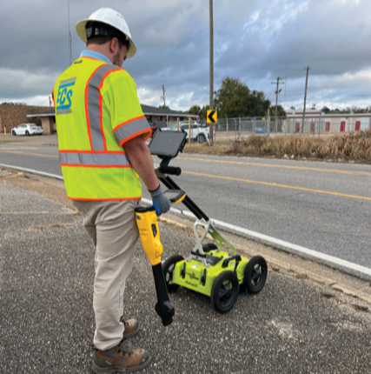
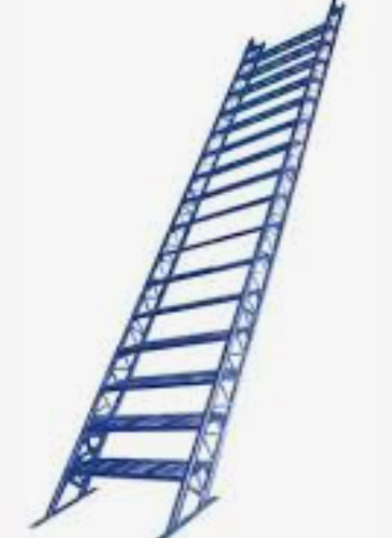
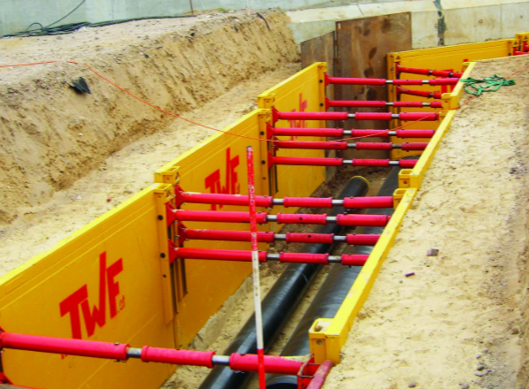
FOB TECH ACADEMY
Trench and Excavation Safety Protocols
Trench Design and Support
Protective Systems: Use trench boxes, shoring, or sloping to prevent trench collapses.
Shoring: Supports the walls of the trench using metal or wooden reinforcements.
Trench Boxes: Prefabricated structures that create a safe working area inside the trench.
Sloping: Cuts the trench walls at an angle to reduce stress and the risk of collapse.
Depth Considerations: Trenches deeper than 1.2 meters (4 feet) require additional safety measures and inspections.
Access and Egress
Ladders and Ramps: Provide safe entry and exit points at intervals not exceeding 7.6 meters (25 feet) for trenches deeper than 4 feet.

Slide 9
FOB TECH ACADEMY
Trench and Excavation Safety Protocols
Pre-Work Site Assessment
Soil Analysis: Determine soil stability and type (e.g., sandy, clay, or rocky) to decide appropriate protective measures.
Utility Location: Identify and mark existing underground utilities using tools like ground-penetrating radar (GPR) to avoid accidental strikes.
Weather Conditions: Plan excavation activities based on weather forecasts to prevent waterlogging or trench collapses.
Hazard Monitoring
Air Quality Checks: Monitor for hazardous gases or oxygen deficiencies in trenches deeper than 1.2 meters.
Real-Time Inspections: Inspect trenches daily and after weather changes or heavy machinery use to ensure safety.

Slide 10


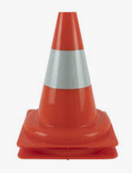
FOB TECH ACADEMY
Trench and Excavation Safety Protocols
Machinery Operation
Safe Distances: Keep heavy machinery at least 1 meter (3 feet) away from trench edges to prevent collapses.
Operator Training: Ensure operators are trained and certified to use excavation equipment safely.
Worker Training and Awareness
Emergency Response Plans: Train workers on evacuation and rescue procedures in case of trench collapses or other emergencies.
Hazard Identification: Educate workers on identifying and reporting unsafe conditions.
Site Marking and Barriers
Warning Signs: Use signs to alert workers and the public about excavation activities., apply warning tape in all trenched pit like 0.5m from the surface to alert anyone that want to dig in future
Barricades and Tape: Secure the trench area to prevent unauthorized access.

Slide 11
FOB TECH ACADEMY
Equipment Operation and Maintenance
Manual Tools:
  Shovels and Digging Bars: Ideal for small-scale or precision trenching tasks.
  Post Hole Diggers: Useful for creating narrow, deep trenches.
Mechanized Equipment:
  Trenchers:
    Chain Trenchers: For digging narrow, deep trenches.
    Wheel Trenchers: Suitable for rocky terrains or hard soils.
  Excavators: Versatile for digging wider or deeper trenches and moving soil.
  Horizontal Directional Drilling (HDD) Machines: Used for trenchless installations, minimizing surface disruption.

Slide 12
FOB TECH ACADEMY
Equipment Handling and Maintenance
Equipment Handling
Pre-Operational Checks:
  Inspect equipment for any visible damage or wear before use.
  Ensure fuel and hydraulic fluid levels are sufficient.
Safe Operation Practices:
  Only trained and certified operators should handle mechanized equipment.
  Maintain a safe distance from the trench edge to prevent collapses.
  Follow manufacturer guidelines for operation to prevent overloading or misuse.
Post-Use Care:
  Clean equipment after use to remove dirt, debris, or corrosive substances.
  Store tools in a dry, secure location to prevent damage or theft.
Equipment Maintenance
Regular Inspections:
  Check for wear and tear on components such as chains, blades, and hydraulic systems.
  Inspect tires, tracks, and other moving parts for proper function.
Scheduled Servicing:
  Follow manufacturer-recommended maintenance schedules for oil changes, filter replacements, and lubrication.
  Ensure calibration and alignment of cutting tools for optimal performance.
Repairs and Replacements:
  Address minor issues promptly to prevent larger mechanical failures.
  Replace worn-out parts to maintain efficiency and safety.

Slide 13
FOB TECH ACADEMY
Environmental Considerations
i. Proper Disposal of Waste Materials
Segregation: Separate waste into recyclable, reusable, and non-recyclable categories.
Disposal: Follow local regulations for disposing of soil, debris, and other waste, using designated landfills or recycling centers.
Hazardous Waste: Properly handle and dispose of materials like oil, fuel, or contaminated soil to prevent pollution
ii. Minimizing Impact
Erosion Control: Use silt fences or mats to prevent soil erosion and sediment runoff.
Vegetation Protection: Avoid unnecessary removal of trees and plants; replant where possible after installation.
Noise and Dust Reduction: Use equipment with noise-dampening features and water sprays to suppress dust.
Trenchless Methods: Consider methods like Horizontal Directional Drilling (HDD) to reduce surface disruption.

Slide 14
FOB TECH ACADEMY
INSTALLATION TECHNIQUES
Fiber optic network installation requires precise planning, careful execution, and following technical standards. The process involve several steps to ensure seamless deployment and long-term efficiency of operation.
Pre-Installation Planning:
Pre-installation planning is a crucial stage in fiber optic network deployment. It ensures that all aspects of the project are carefully considered, minimizing risks, reducing delays, and optimizing resources. This phase lays the foundation for successful installation and long-term operational efficiency.

Slide 15
FOB TECH ACADEMY
INSTALLATION TECHNIQUES
Pre-Installation Planning:
Pre-installation planning is a crucial stage in fiber optic network deployment. It ensures that all aspects of the project are carefully considered, minimizing risks, reducing delays, and optimizing resources. This phase lays the foundation for successful installation and long-term operational efficiency.
Blueprints and network design:
These are critical for visualizing the fiber optic layout and ensuring the installation aligns with project goals

Slide 16
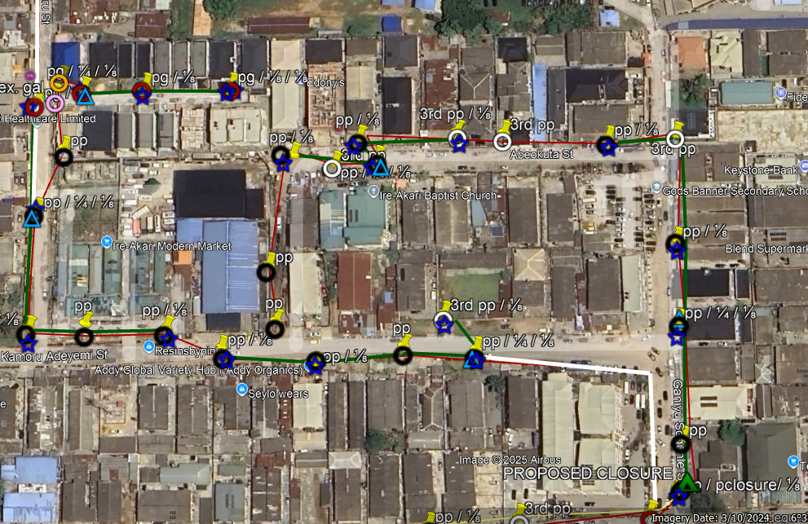
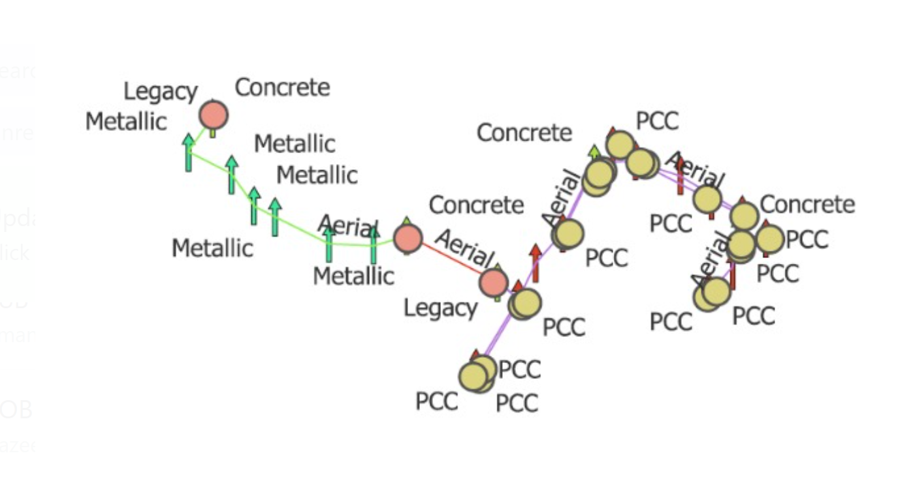
FOB TECH ACADEMY
FTTH Design Software (KMZ, GIS)
KMZ (Google Earth Format)
Use Case: KMZ files are used to visualize fiber routes on satellite imagery.
Advantages:
  Provides a realistic, geographic view of the project area.
  Useful for site surveys and stakeholder presentations.
    Allows easy overlay of network designs with existing infrastructure.
Applications: Exporting routes from GIS or AutoCAD into KMZ for real-world alignment.
GIS (Geographic Information System)
Use Case: GIS tools are used for mapping, analyzing, and managing geospatial data related to fiber deployment.
Advantages:
  Provides detailed data layers such as terrain, population density, and existing utilities.
  Optimizes route planning by identifying the shortest and most cost-effective paths.
  Enables real-time tracking of installation progress.
Applications: Long-distance network designs, ROW analysis, and compliance checks.

Slide 17
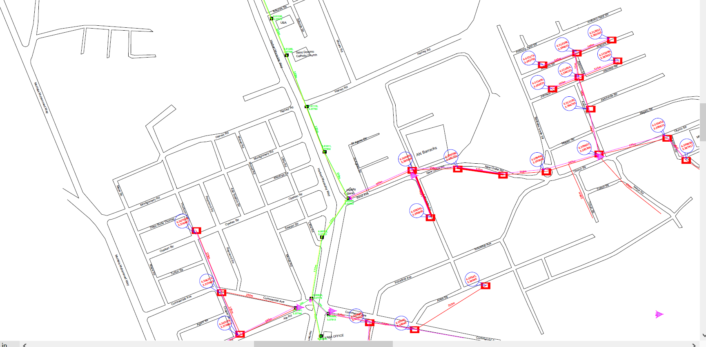
FOB TECH ACADEMY
FTTH Design Software (AutoCAD)
Use Case: AutoCAD is a drafting tool for creating detailed engineering designs and schematics.
Importance:
  Offers precision in designing duct paths, splice points, and joint enclosures.
  Generates technical drawings required for regulatory approval and on-site installation.
  Supports integration with GIS for enhanced functionality.
Applications: Urban network designs, cross-sectional drawings, and conduit layouts.

Slide 18
FOB TECH ACADEMY
Site Preparation and Marking/Staking
Site Preparation
Initial Assessment
Conduct site visits to inspect terrain, identify obstacles, and verify design feasibility.
Evaluate soil type, weather conditions, and potential environmental impacts.
Clearance and Accessibility
Remove debris, vegetation, or any obstructions along the planned fiber routes.
Ensure clear access for equipment and vehicles to the site.
Utility Location and Marking
Identify and mark the positions of underground utilities such as gas, water, or electrical lines using tools like ground-penetrating radar.
Prevent accidental damage and ensure compliance with local regulations.
Site Marking/Staking
Marking Fiber Routes
Use spray paint, stakes, or flags to indicate the exact paths for trenches, conduits, and cable runs.
Different colors may be used to represent various utilities (e.g., red for electrical, blue for water).
Positioning Key Features: Clearly mark locations for
Splice points.
Handholes and manholes.
Equipment cabinets or OLT (Optical Line Terminal) enclosures.
Compliance with Standards
Follow local regulations and standards for site marking to ensure accuracy and safety.
Coordinate markings with utility companies and municipal authorities to avoid conflicts.

Slide 19
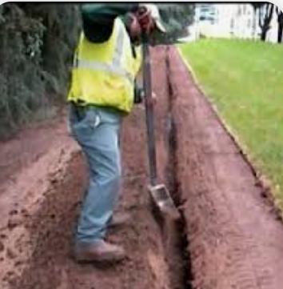
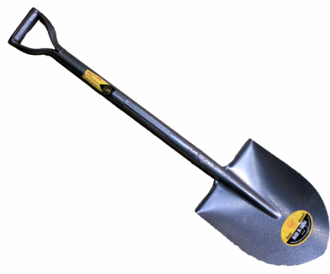

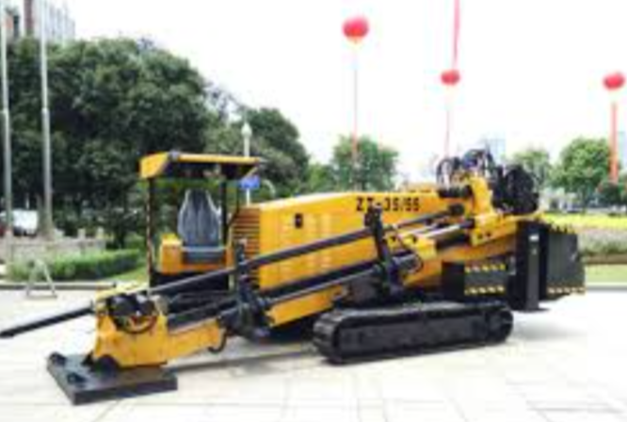
FOB TECH ACADEMY
Trenching Techniques and Installation Procedures
Manual Excavation: Shovels and Digger
Use Case: Suitable for small-scale projects, areas with restricted access, or when precision is required near existing infrastructure.
Tools: Shovels, spades, and diggers are employed to create trenches manually.
Advantages: Cost-effective for short distances, minimal environmental disturbance, and ideal for sensitive zones.
ii. Machine Excavation: Horizontal Directional Drilling (HDD)
Use Case: Ideal for trenchless installations under roads, waterways, or existing structures.
Equipment: HDD machines create underground pathways without disturbing the surface significantly.
Advantages: Reduces surface disruption, minimizes environmental impact, and allows installation in challenging terrains.

Slide 20
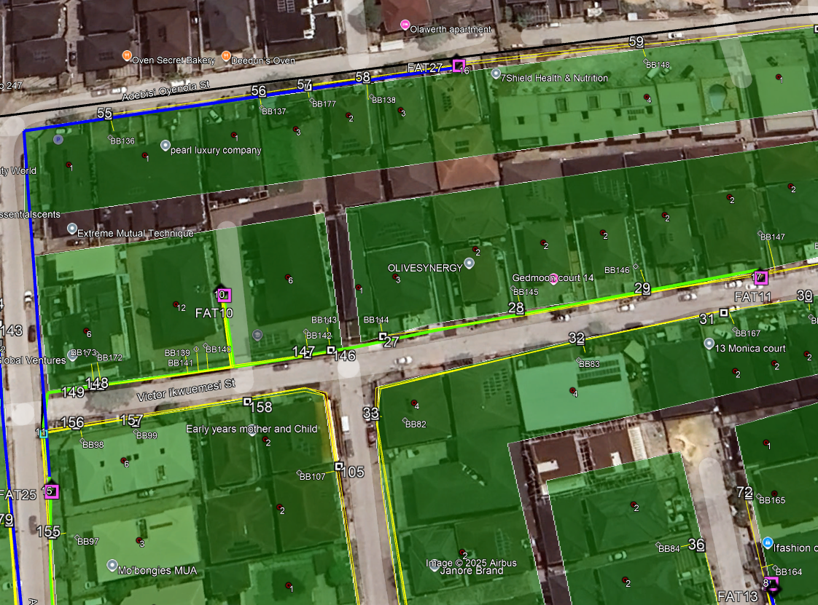
FOB TECH ACADEMY
Project Management Life Cycle for Fiber Optic Projects
Initiation Phase
Defining Objectives: Establish project goals such as the scope of fiber deployment (FTTH, metro networks, or backbone infrastructure) and expected outcomes, including speed and reliability improvements.
Feasibility Studies: Evaluate factors like terrain challenges, existing infrastructure, and potential regulatory hurdles. For example, assessing the viability of aerial vs. underground fiber routes.
Stakeholder Engagement: This require telling the client of the mode of deployment, giving report to the sponsor of project for approval and also informing the government where approval is required
Resource Estimation: Outline initial resource requirements, like distance of fiber, number of handholes, all these will reflect in the bill of quantity.
Planning Phase
Route Planning: This is the aspect of designing making use of the tools like Google map, GIS to come out with a schematic diagram fiber routes, considering geographical features, road crossings, and existing utility lines.
Risk Management: Identify risks such as cable damage from construction activities, weather impacts on deployment timelines, if possible, consider sabotage. Develop mitigation plans, such as reserving extra cables or securing alternative routes.
Budget Allocation: Allocate funds for major components like ducts, manholes, fiber cables, and splicing labor.
Permitting and Approvals: Obtain necessary permits from local authorities, such as wayleave approvals for crossing private or public land.

Slide 21
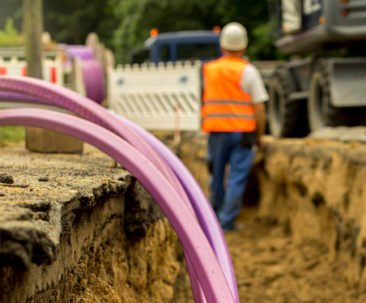
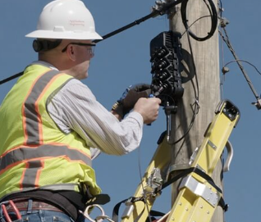
FOB TECH ACADEMY
Project Management Life Cycle for Fiber Optic Projects
Execution Phase
Trenching and Duct Installation: Perform civil works such as trenching, micro-trenching, or using boring machines for underground ducting. Ensure trenches meet required depths for protection against accidental damage.
Fiber Installation and Splicing: Deploy fiber optic cables using appropriate techniques (pulling, blowing, or laying). Follow up with precise splicing to ensure minimal signal loss.
Testing and Inspection: Perform tests such as OTDR (Optical Time-Domain Reflectometer) measurements to verify the integrity of the fiber and detect faults.

Slide 22

FOB TECH ACADEMY
Project Management Life Cycle for Fiber Optic Projects
Monitoring and Control Phase
Quality Control: Inspect completed sections of the network to ensure compliance with industry standards, such as ITU-T recommendations and all other specification within the company, like MEC.
Risk Mitigation: Address issues such as damaged ducts or delays in approvals with contingency measures like on-the-spot repairs or route adjustments.
Real-Time Reporting: Use project reporting tools such as whatAsap, bitrix or any project management software to update stakeholders on progress and flag critical issues.

Slide 23
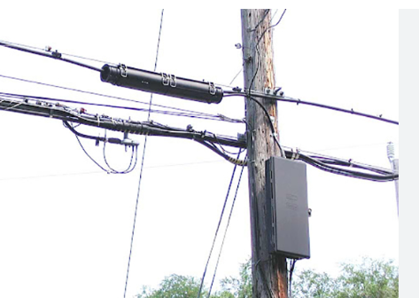
FOB TECH ACADEMY
Project Management Life Cycle for Fiber Optic Projects
Closing Phase
Final Testing: Conduct end-to-end testing to confirm that the network delivers the required dB power, known as bandwidth, latency, and reliability.
Documentation: Provide as-built documentation, including maps, splice diagrams, and test results, for future maintenance.
Handover and Training: Transfer ownership to the client or service delivery/maintenance tea and train their team on network operation and troubleshooting.
Post-Project Review: Analyze the project’s performance to identify successes and areas for improvement in future deployments. Also document all lesson learn while deploying project AV

Slide 24
THANKS FOR LISTENING

